Slide 1

NorCal
Continuum of Care (CoC)
Presenters:
CHANITA JACKSON- Technical Assistance Collaborative (TAC)
NICK NORDAHL-U.S. Department of Housing and Urban Development (HUD)
KRISTEN SCHREDER- Chair of the Executive Board
SHAWNNA-City of Redding Housing Department
CA-516- SHASTA, REDDING, SISKIYOU, LASSEN, PLUMAS, DEL NORTE MODOC AND SIERRA COUNTIES

Slide 2
HUD POLICY PRIORITIES FOR HOMELESSNESS
Ending homelessness for all persons
  Foundations: Equity, data and evidence
  Solutions: Housing and Supports, Crisis response and prevention
Improving systems performance
  Enhance Coordinated Entry
  Strengthen Housing Focused Practices
  Scale Permanent Housing Interventions
  Ongoing Performance Management
3. Housing First*
  Immediate access to permanent housing with no housing readiness requirements
  Consumer choice and self-determination
  Recovery orientation
  Individualized and client-driven supports
  Social and community integration

Slide 3
Key Terms
CoC = Continuum of Care (can be referred to as program funding AND a certain geographic area)
NOFA/O= Notice of Funding Availability/Opportunity
CA = Collaborative Applicant (also referred to as the “CoC Lead Agency”)
CES = Coordinated Entry System
HMIS = Homeless Management Information System
Consolidated Application = Application for the entire CoC + individual project applications + priority listing
Priority Listing = Ranked List = Local competition results
HIC = Housing Inventory Count
PIT= Point in Time Count
LSA= Longitudinal Systems Analysis (data used for the AHAR)
HDX = Homelessness Data Exchange
SPM = System Performance Measures

Slide 4
CoC Definition
A Continuum of Care (CoC) is the group organized to carry out the responsibilities prescribed within the CoC Program Interim Rule for a defined geographic area.
A CoC should be composed of representatives inclusive of local organizations (either funded or unfunded)
Put Plainly: The CoC is a planning body responsible for coordinating the communities policies, strategies and activities to prevent and end homelessness (paying particular focus on federal funding).

Slide 5
CoC Program Interim Rule 24 CFR 578 Requires:
Communities to establish a CoC for the geographic area to receive CoC program funding
CoC must establish a board to act on behalf of the Continuum using the process established by 24 CFR 578.7(a)(3) and must comply with the conflict-of interest requirements of 24 CFR 578.95(b).
CoC Board must:
  Be representative of relevant organizations and or projects serving homeless subpopulations; and
  Include at least one person with lived experience

Slide 6

CoC Roles and Responsibilities
CoC
Executive Board
Establishes a Board of Directors, selects the Collaborative Applicant and HMIS Lead Agency, designates entity(s) to carry out activities outlined in 24 CFR 578.7-9
Provides leadership to the CoC and engages in other activities designated to them by the CoC
Prepares and submits the annual CoC Program application to HUD for funding, applies for CoC Planning Grant and engages in planning activities designated by the CoC

Slide 7
Governance and the CoC
How does this all connect?
  In the context of the Continuum of Care (CoC) program, Governance is the practice of providing oversight for the policy and interventions of the community's effort to prevent and end homelessness.
What are we required to do?
  The CoC must create a governance charter which formally documents how responsibilities are assigned within the CoC, and explanations associated with how work will be conducted.
The right way?
  There is no “one or right” way to govern a CoC aside from complying with the guidance outline in the CoC Program Interim Rule.

Slide 8

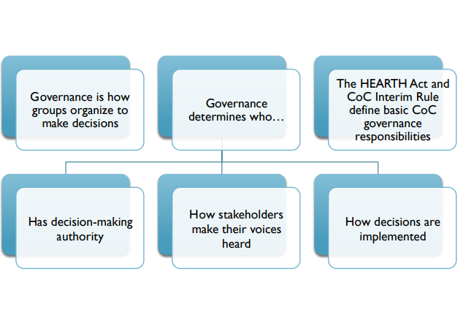
What is Governance?

Slide 9
Governance Requirements
Include
Invite | New members annually
Hold | Meetings of the full CoC at least twice a year
Adopt | Board selection process review, update and/or approved once every 5 years, evidence required for designating a single HMIS for the Continuum.
Appoint | Committees and workgroups
Update | Annually update governance charter in coordination with the Collaborative Applicant and HMIS Lead

Slide 10
Governance Charter
Outlines all functions and responsibilities assigned by the CoC to the Board, Committees, the HMIS Lead, the Lead Agency staff, as well as the process for reviewing and amending the charter.
Speaks to the who, what, when, where and why of the CoC responsibilities.
This work must be done collaboratively;
  The collaborative applicant can take on additional responsibilities but should not be the primary driver or the only driver of goals/practices of the CoC

Slide 11
CoC Governance Structure
NorCal Continuum of Care (CoC)
CA-516
HMIS/Coordinated Entry Lead
CoC Executive Board
CoC Advisory Board
Collaborative Applicant
Committees
Workgroups

Slide 12

Governance
Rose
  What's Working- Where is success?
    Robust public meetings
    Great opportunities to solicit feedback
    The City of Redding serves as the CoC’s Administrative entity; who is responsible to provide guidance to ensure the duties of the CoC are met.
      One of the priority of the administrative entity is to aggressively seek additional funding and resources to strengthen and enhance funding priorities adopted within the Strategic Plan

Slide 13

Governance
Where are the current gaps?
    Limited CoC Funding
    Expired Administrative Performance Review
    Consider Centering Racial Equity in the CoC Governance
      Targeted outreach and invitations to by and for entities i.e. Black Indigenous, People of Color,
      Meaningful Involvement of Persons with Lived Experience
      Youth and young adult representation

Slide 14

Governance
Bud
  Where do we have room to grow?
    Proactive outreach efforts- Targeting and prioritizing the most vulnerable populations, i.e. BIPOC, LGBTQ+, Unaccompanied Youth/Young Adults, Families, Seniors and those who Identify as medically fragile
    Proactive outreach efforts- Targeting Law enforcement agencies, including probation and parole
    Strengthen language in the current governance charter around term limits, voting structure and CoC responsibilities/Board Roles

Slide 15

Governance
Brainstorm
  Lets take 2-3 minuets to reflect the current governance and identify one or two top priorities that you would like to see addressed or strengthened in the current governance structure.

Slide 16
Things To Consider
We will need to update the governance charter to reflect and changes to roles and responsibilities
Document any new policies and procedures that the Executive Board agree to
Identify single HMIS implementation process
Develop and unifying set of written policies ad procedures to govern coordinated entry for all participating organizations within the CoC.
Identify and update CoC collaboration roles and responsibilities

Slide 17
Next Steps
Gather CoC partners for Governance discussion
Review and analyze CoC board roles and responsibilities
Review and analyze your CoC’s collaboration capacity
Review other available resources
Update, analyze and execute updated CoC Governance Charter

Slide 18
Resources
CoC Collaborative Applicant Annual Activities - HUD Exchange
HUD Annual Requirements: CoC Collaborative Applicant Activities (hudexchange.info)
Trainings - HUD Exchange
Establishing and Operating a Continuum of Care (hudexchange.info)
CoC Governance Charter Podcast - HUD Exchange
60-Collaborative-Applicant-FO-Roles-and-Responsibilities.pdf (csh.org)
eCFR :: 24 CFR Part 578 -- Continuum of Care Program
Continuums of Care (CoC) Mergers - What to Consider? (hudexchange.info)
Continuum of Care (CoC) Mergers - Options Analysis (hudexchange.info)
CoC Merger Resource Guide: Challenges and Recommendations From the Field (hudexchange.info)
CoC-Merger-Funding-Analysis-Tool.xlsx (live.com)

Slide 19

Questions

