Slide 1
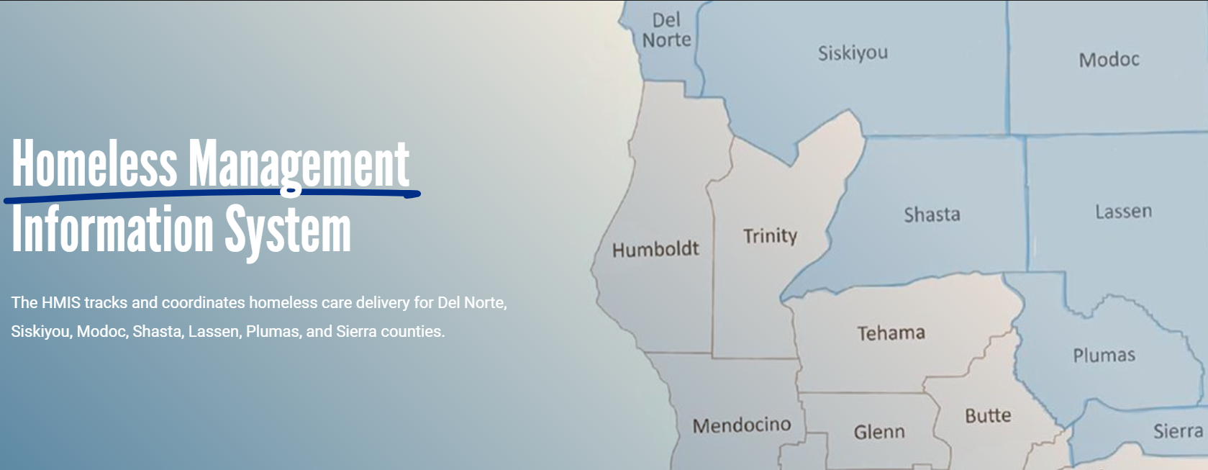

System Administration Update
2/15/24

Slide 2

Homeless Management Information System
HMIS is the data system for intake, assessment, and prioritization of community members in homelessness
The system holds the personal data of sheltered and unsheltered individuals and families
This type of system is federally required with consequences tied to not using the system correctly.
HMIS data is used for funding decisions and allocations at state and federal levels

Slide 3
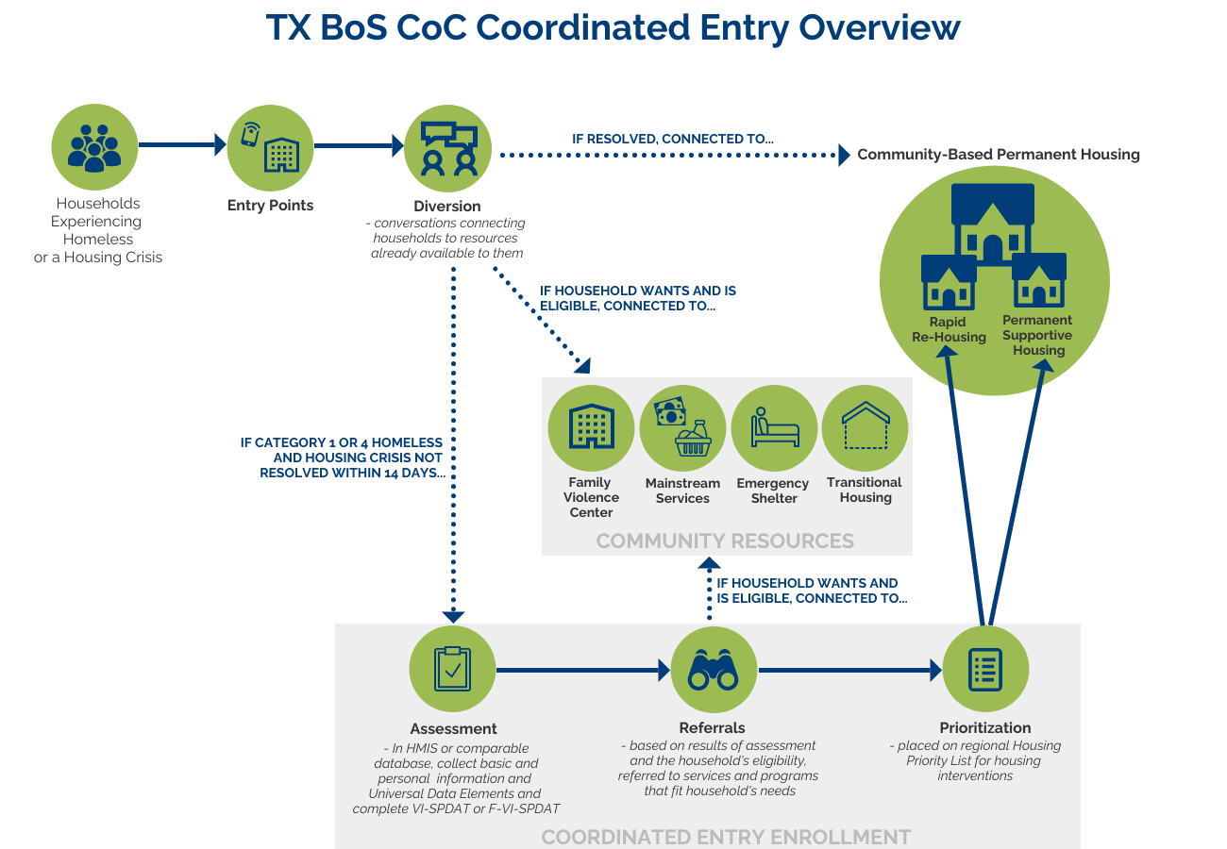
Coordinated Entry
  Graphic provided by Texas Balance of State Continuum of Care

Slide 4
Current Status
Assumed management with 2 weeks preparation time
Hired 1 of 2 staff, repositioned UWNC leadership and support staff
Discovering the depth of the need
    82 remaining LSA warnings
      staff time estimated at 14-82 hours to correct
    Projects and Agency Data
      Not completed
      Errors in entry contact information
      Agency unable to address the issue without training and guidance
Secured key TA and training support
Completed End User agreements with current agencies
Beginning to onboard new projects, users and agencies, establishing agreements with agencies
Initiated training program redesign and resources

Slide 5
Success in just 6 weeks
Eliminated insurance and license fee requirement for end user agencies
Submitted mandatory reports (LSA, PIT/HIC, Quarterly HDIS)
Successfully supported PIT/HIC data collection
Reduction of 10-20% of clients on County and population centered lists

Slide 6
Goals
Increase service provider participation 6 - 9 months
  Onboard primary emergency housing programs
  Maximize all funded licenses in 2024 & 2025
    Minimum 125 licenses allocated and active
    Beginning in April maintain a monthly active user rate of 90%
  Collaborate to enhance access for community members.
Improve system functionality 3 – 15 months
System analysis with the platform vendor – June 2024
Provide enhanced training and technical assistance Develop system guide, standard operating procedures, training videos and WellSky training platform
  Recommend and implement real time system adjustments in coordination with the HMIS/CE committee
  Develop action plan collaboratively
Reduce/remove barriers for agency utilization 1 - 6 months
  Fund user licenses for 2 years
  Address insurance requirement barrier
  Simplify end user experience
    Survey CoC members and End Users by August 2024

Slide 7

Current Needs
Management and Leadership buy-in
System Operations Funding
    Clear, accessible funding paths
    Increase and stabilize license fee coverage
Increased Staffing Support: program oversight, system development, and technical assistance
    +.65 Program Analyst
    +.05 Sr. Director of Programs
    +.10 Sr. Manager

Slide 8
THANK YOU
Larry Olmstead
President/CEO
lolmstead@norcalunitedway.org
Kalie Brisbon
Senior Director of Programs
kbrisbon@norcalunitedway.org
Tim Danielson
Senior Manager of Homelessness
tdanielson@norcalunitedway.org

