Slide 1

Public Meeting #3, February 22, 2024
Regionally Coordinated Homelessness Action Plan for Homeless Housing, Assistance and Prevention (HHAP) Round 5

Slide 2
Introductions
Sherry Morgado, Community Development Manager
Cassie Miracle, Community Development Project Manager
Sareena Rai, Community Development Planner
Please place your name, County of residence and your agency (if you represent one) in the Zoom Chat. If you are a member of the general public, please input your name, County of residence, and “public” in the Zoom Chat
If you need any help using Zoom technology, please send a message in the Zoom “Chat” feature to Sareena Rai

Slide 3
Group Agreements
Participate with intention & contribute positive feedback
Appreciate the diversity of perspectives
Maintain a respectful space

Slide 4

Agenda
Brief Background on HHAP-5 Funding
Review of Proposed Actions from HHAP-3 and HHAP-4
Brainstorming on New Key Actions for HHAP-5
Questions and Comments
Next Steps

Slide 5
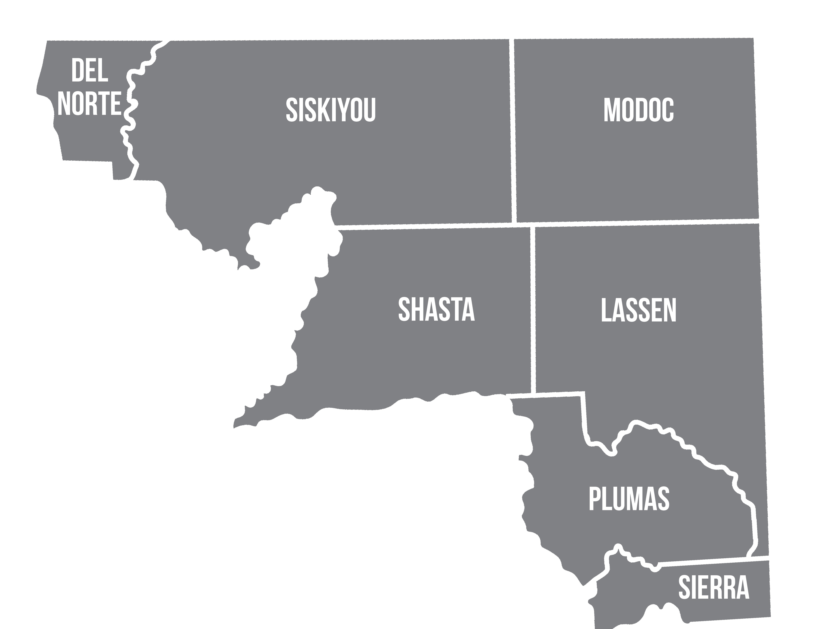
NorCal Continuum of Care Service Area

Slide 6
Background on HHAP-5
The Homeless Housing Assistance and Prevention (HHAP) Prevention Program was created by the California State Legislature in 2019. Funding has been released in rounds via Notices of Funding Availability (NOFAs) to eligible applicants.
Eligible applicants for HHAP are the 44 Continuums of Care, 58 counties, and 14 largest cities with populations over 300,000.
This grant program provides local jurisdictions with flexible funding to continue efforts to improve regional and systems coordination to prevent and end homelessness in their communities.

Slide 7
Background on HHAP-5
The Homeless Housing Assistance and Prevention (HHAP) Round 5 Notice of Funding Availability (NOFA) was published Sept 29, 2023.
HHAP-5 requires three public meetings, a Regionally Coordinated Homelessness Action Plan (Plan), a Memorandum of Understanding (MOU) signed by each participating County, and a Funding Plan or Plans (if counties apply to receive and manage their allocations directly from the State).
HHAP-5 allocations consist of an allocation for the entire CoC (which the CoC divides up based on each county’s share of individuals counted in the most recent PIT) and a separate allocation for each county.

Slide 8
HHAP-5 Allocations
Continuum of Care Allocation: $3,625,173.51
County Allocations:
  Del Norte: $957,459.26
  Lassen: $184,869.66
  Modoc: $37,249.86
  Plumas: $184,869.66
  Shasta: $1,397,559.41
  Sierra: $16,555.55
  Siskiyou: $699,469.52

Slide 9

Review of Actions from HHAP-3 and HHAP-4
Provide Housing Navigation and Housing Retention services in each county through an expansion of case management staff and multi-disciplinary teams utilizing HHAP and PLHA funds.
Increase non-congregate shelter options with a connection to Housing Navigation services utilizing a trauma-informed Housing First model.
Expand the supply of permanent supportive housing by utilizing funds from Homekey, PLHA and HHAP to purchase and renovate a minimum of 2 hotels to be operated as permanent supportive housing.
Evaluate BIPOC underserved groups and disproportionate impacts by County. Develop a CoC Committee with County representatives to develop action plans and share best practices to reach and engage with these groups. Include individuals who represent these groups with a lives experience of homelessness on the Committee (at least one representative per County from these groups) and provide them with a paid stipend to attend meetings.
Through formal MOUs, develop, expand and strengthen partnerships with other community agencies and organizations who serve those with mental illness, substance use disorders, veterans, DV survivors and unaccompanied youth to address funding available that can be leveraged to prevent homelessness.

Slide 10
SPMs and Equity Plan for HHAP-5: Brainstorming Key Actions
The heart of the Regionally Coordinated Homelessness Action Plan are the Key Actions to address The System Performance Measures (SPMs) and the Equity Plan. This is what we will be focused on today
Today, we plan to keep as many people together as possible in one group for brainstorming
If we have more than 25 people/groups logged on, we’ll split into two groups
In person watch parties with more than 10 people will brainstorm together; those with 10 or fewer will stay with the larger group

Slide 11
System Performance Measures and Improvement Plan
System Performance Measures have been provided by Cal ICH
Describe key actions the region intends to take to improve each System Performance Measure
  Strategic initiatives or key steps. Can be policy, program, partnership, target metric or other approach which reflects an improvement delivering positive impact. Must describe intended outcome.
  Lead Entity which will manage the action
  Collaborating entities
  Timeframe
  Success measure method

Slide 12
System Performance Measures and Racial/Ethnic Disparities
Each System Performance Measure asks for an analysis of any racial and ethnic disparities that the data is showing for that measure.
We’ve used both PIT and HMIS data for the analysis, with ACS data (Census Bureau) used to provide community-wide baselines.
In general, our analysis shows that Indigenous/Native American, Black/African-American, other People of Color and people of two or more races are disproportionately impacted by homelessness and not being equitably served and housed compared to other races/ethnicities.
As we discuss each SPM, we will note the specific disparities we found.

Slide 13
Equity Improvement Plan
Describe key actions the region intends to take to ensure racial and gender equity in:
  Service Delivery; Housing Placements; Housing Retention
  Key Actions to change procurement or other means to affirm equitable access to housing and services for over-represented groups
Lead Entity
Collaborating Entities

Slide 14

Brainstorming

Slide 15
Schedule and Next Steps
Date | Activity
March 7, 2024 | Special Executive Board Meeting to Review Draft Plan
March 2024 | Counties’ Governing Body Meetings to Adopt Plan and Approve MOU
No Later Than March 27, 2024 | Submit HHAP-5 Plan/Application to Cal ICH via Online Submission Platform *Note: Cal ICH has 90 days to review the submitted plan/application, request amendments, or approve application and issue award notice.

