Slide 1

Public Meeting #2, February 8, 2024
Regionally Coordinated Homelessness Action Plan for Homeless Housing, Assistance and Prevention (HHAP) Round 5

Slide 2
Introductions
Sherry Morgado, Community Development Manager
Cassie Miracle, Community Development Project Manager
Sareena Rai, Community Development Planner
Please place your name, County of residence and your agency (if you represent one) in the Zoom Chat. If you are a member of the general public, please input your name, County of residence, and “public” in the Zoom Chat
If you need any help using Zoom technology, please send a message in the Zoom “Chat” feature to Sareena Rai

Slide 3
Group Agreements
Participate with intention & contribute positive feedback
Appreciate the diversity of perspectives
Maintain a respectful space

Slide 4

Agenda
Brief Background on the NorCal Continuum of Care
Brief Background on HHAP-5 Funding
Summary of Input from Public Meeting #1
Tonight’s Focus: Pathways to Equity
      Findings and Actions from HHAP-3 and HHAP-4
      Breakout Groups: Brainstorming on Reducing Disparities
Questions and Comments
Final Public Meeting and Next Steps

Slide 5
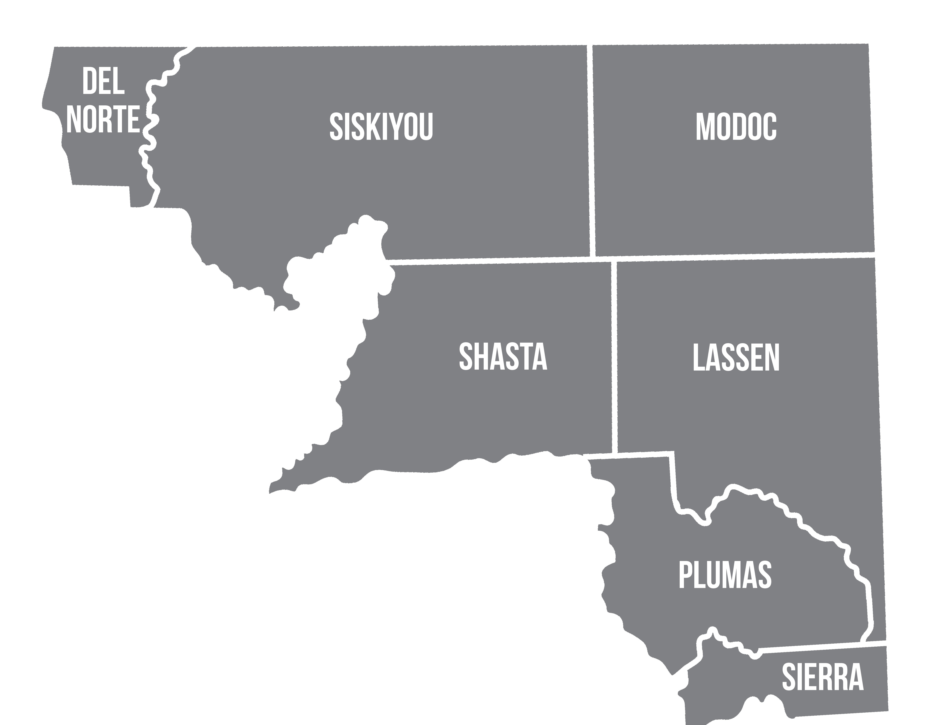
NorCal Continuum of Care Service Area

Slide 6
Background on NorCal
Continuum of Care (CoC)
Lead Agency: City of Redding
  Enters into funding agreements with HUD, HCD and Cal ICH
HMIS Lead Agency: United Way of Northern California
  Management of the Homeless Management Information System (data-tracking system) and Coordinated Entry System
CoCs both receive and distribute funding from a variety of sources, including HUD CoC Funding, State Emergency Solutions Grant and Homeless Housing Assistance and Prevention funding, and other special funding made available from time to time to CoCs and their county members.

Slide 7
Background on HHAP-5
The Homeless Housing Assistance and Prevention (HHAP) Prevention Program was created by the California State Legislature in 2019. Funding has been released in rounds via Notices of Funding Availability (NOFAs) to eligible applicants.
Eligible applicants for HHAP are the 44 Continuums of Care, 58 counties, and 14 largest cities with populations over 300,000.
This grant program provides local jurisdictions with flexible funding to continue efforts to improve regional and systems coordination to prevent and end homelessness in their communities.

Slide 8
Background on HHAP-5
The Homeless Housing Assistance and Prevention (HHAP) Round 5 Notice of Funding Availability (NOFA) was published Sept 29, 2023.
HHAP-5 requires three public meetings, a Regionally Coordinated Homelessness Action Plan (Plan), a Memorandum of Understanding (MOU) signed by each participating County, and a Funding Plan or Plans (if counties apply to receive and manage their allocations directly from the State).
HHAP-5 allocations consist of an allocation for the entire CoC (which the CoC divides up based on each county’s share of individuals counted in the most recent PIT) and a separate allocation for each county.

Slide 9
HHAP-5 Allocations
Continuum of Care Allocation: $3,625,173.51
County Allocations:
  Del Norte: $957,459.26
  Lassen: $184,869.66
  Modoc: $37,249.86
  Plumas: $184,869.66
  Shasta: $1,397,559.41
  Sierra: $16,555.55
  Siskiyou: $699,469.52

Slide 10
State Priorities
HHAP-5 funds are intended to sustain existing federal, state and local investments toward long-term sustainability of housing and supportive services.
HHAP-5 recipients are required to:
  Prioritize permanent housing solutions
  Address racial disparities for groups disproportionately experiencing homelessness and achieve equitable provision of services for those groups, especially for Black, Native and Indigenous, Hispanic/Latiné, Asian/Pacific Islanders and other People of Color.

Slide 11
Summary of Input from Public Meeting #1: Pathways to Permanent Housing
HHAP-3 Goals should be continued
A variety of housing types are needed, including apartments, manufactured homes, and tiny homes
The transition from the street to PSH can be difficult for some people, so transitional housing is needed
Ongoing outreach and relationship building is very important
Non-congregate shelters need to be part of the solution
Funding should be used to sustain current programs that are working
Additional wrap-around supportive services of all kinds and for longer periods of time
Trauma-informed services and peer support
Opportunities to build community, no matter the housing type

Slide 12
Findings from HHAP-3 and HHAP-4 Relating to Disparities and Equity
Disparities in Unsheltered Homelessness: People who are Native American/Alaskan Native represent 6% of the total population in the seven-county CoC region, but account for 11% of those experiencing unsheltered homelessness.
Disparities in Accessing Services: People who are Native American /Alaskan Native represent 11.3% of the homeless population across the seven-county CoC region, but only constitute 3.7% of those who are accessing services while experiencing homelessness.
Disparities in Exiting Homelessness into Permanent Housing: People who are Native American/Alaskan Native represent 11.3% of the homeless population across the seven-county region but only constitute 3.6% of those who are being moved into permanent housing.

Slide 13
Findings from HHAP-3 and HHAP-4 Relating to Disparities and Equity
Disparities in Length of Time Persons Remain Homeless: People who are Black and/or African American, Multiple Races (especially Black and/or African American and Hispanic/Latiné or Multiple Races and Hispanic/Latiné), as well as Parenting Youth ages 18-24 are homeless for a significantly greater number of days than those from other demographic groups. Those who are Black and Hispanic/Latiné experience homelessness 3 times longer than the average time experienced by all persons in the seven-county CoC region.
Disparities in Returns to Homelessness Within 2 Years After Placement in Permanent Housing: People who are Black and/or African American constitute 45% of people who return to homelessness within 6 months of exiting homelessness to permanent housing, while their overall incidence in the homeless population is 28% in the seven-county CoC region.

Slide 14
Disparities Summary By Group
Native American/Alaskan Native: Unsheltered Homelessness, Accessing Services, Exiting Homelessness into Permanent Housing
Black and/or African-American: Length of Time Persons Remain Homeless, Returns to Homelessness Within 2 Years After Placement in Permanent Housing
Multiple Races (especially Black and/or African American and Hispanic/Latiné or Multiple Races and Hispanic/Latiné): Length of Time Persons Remain Homeless
Parenting Youth Ages 18-24: Length of Time Persons Remain Homeless

Slide 15

Tonight’s Focus:
Pathways to Equity
Action from the HHAP-3 and HHAP-4 Plans Relating to Creating Pathways to Equity:
Evaluate BIPOC (Black, Indigenous, and People of Color) underserved groups and disproportionate impacts by County. Develop a CoC Committee with County representatives to develop action plans and share best practices to reach and engage with these groups. Include individuals who represent these groups with a lived experience of homelessness on the Committee (at least one representative per County from these groups) and provide them with a paid stipend to attend meetings.

Slide 16

Pathways to Equity: Breakout Group Questions
HHAP-3 and 4 action: has this action been undertaken? If not, what will it take to initiate it? Are there other ideas on how to include BIPOC individuals with lived experience in decision-making processes?
Are there local advocacy groups that each County can engage with to help address these disparities? Who are they and what is your relationship with them?
What projects is your organization working on that relate to addressing disparities? What is working well and what is not working well with these projects?
Are there best practices you know of or a program you’ve wanted to pilot regarding disparities and equity?
What are the barriers to addressing these disparities? Are there any incremental steps that can be taken?
How can we make services more culturally or linguistically appropriate to meet the needs of the population?

Slide 17

Addressing Disparities So That Permanent Housing is Achieved and Maintained
Remember to think about actions that address how to move people into permanent housing by addressing disparities.
HHAP-5 funding uses must be focused on permanent housing. Interim housing and supportive services can be funded (as part of existing, ongoing programs or projects) only if they are intended to lead to permanent housing.

Slide 18
How Breakout Groups Will Work
For groups meeting in-person: you should each have a facilitator and a notetaker in your room with handouts that outline the information from the previous slide and you will all meet separately as one group. Sareena will also virtually place you in a Breakout Group so that you do not hear any of the online discussions. We will bring you back to the Main Meeting Room when the time is up and your group facilitator or notetaker will share a summary of your discussion.
For those who are online as individuals: we will have 1 or 2 virtual Breakout Groups here on Zoom. Sareena will randomly place you in a group and you will be asked to participate in that group’s virtual meeting room. You will have both a facilitator and notetaker in your Breakout Group. We will bring you back into the Main Meeting Room when the time is up and your group facilitator or notetaker will share a summary of your ideas.
The Breakout Group discussions will take about 40-45 minutes.

Slide 19

Questions and Comments

Slide 20
Schedule and Next Steps
Date | Activity
February 22, 2024 | Public Meeting #3 (Summary of Recommended Actions and Final Public Comments): Noon-2 PM
Late January - Late February 2024 | Housing Tools Prepares RCHAP and Application Using Feedback from Meetings
Late February - Early March 2024 | CoC Board Will Review RCHAP and Application
March 2024 | Counties’ Governing Body Meetings to Adopt Plan and Approve MOU
No Later Than March 27, 2024 | Submit HHAP-5 Plan/Application to Cal ICH via Online Submission Platform *Note: Cal ICH has 90 days to review the submitted plan/application, request amendments, or approve application and issue award notice.

