Slide 1

Public Meeting #1, January 31, 2024
Regionally Coordinated Homelessness Action Plan for Homeless Housing, Assistance and Prevention (HHAP) Round 5

Slide 2
Introductions
Sherry Morgado, Community Development Manager
Cassie Miracle, Community Development Project Manager
Sareena Rai, Community Development Planner
Please place your name, County of residence and your agency (if you represent one) in the Zoom Chat. If you are a member of the general public, please input your name, County of residence, and “public” in the Zoom Chat
If you need any help using Zoom technology, please send a message in the Zoom “Chat” feature to Sareena Rai

Slide 3
Group Agreements
Participate with intention & contribute positive feedback
Appreciate the diversity of perspectives
Maintain a respectful space

Slide 4

Agenda
Background on the NorCal Continuum of Care
Background on HHAP-5 Funding
Progress on System Performance Measures
Tonight’s Focus: Pathways to Permanent Housing
      Actions from HHAP-3 and HHAP-4
      Breakout Groups: Edits/Additions to Actions
Questions and Comments
Schedule For Remaining Meetings and Next Steps

Slide 5
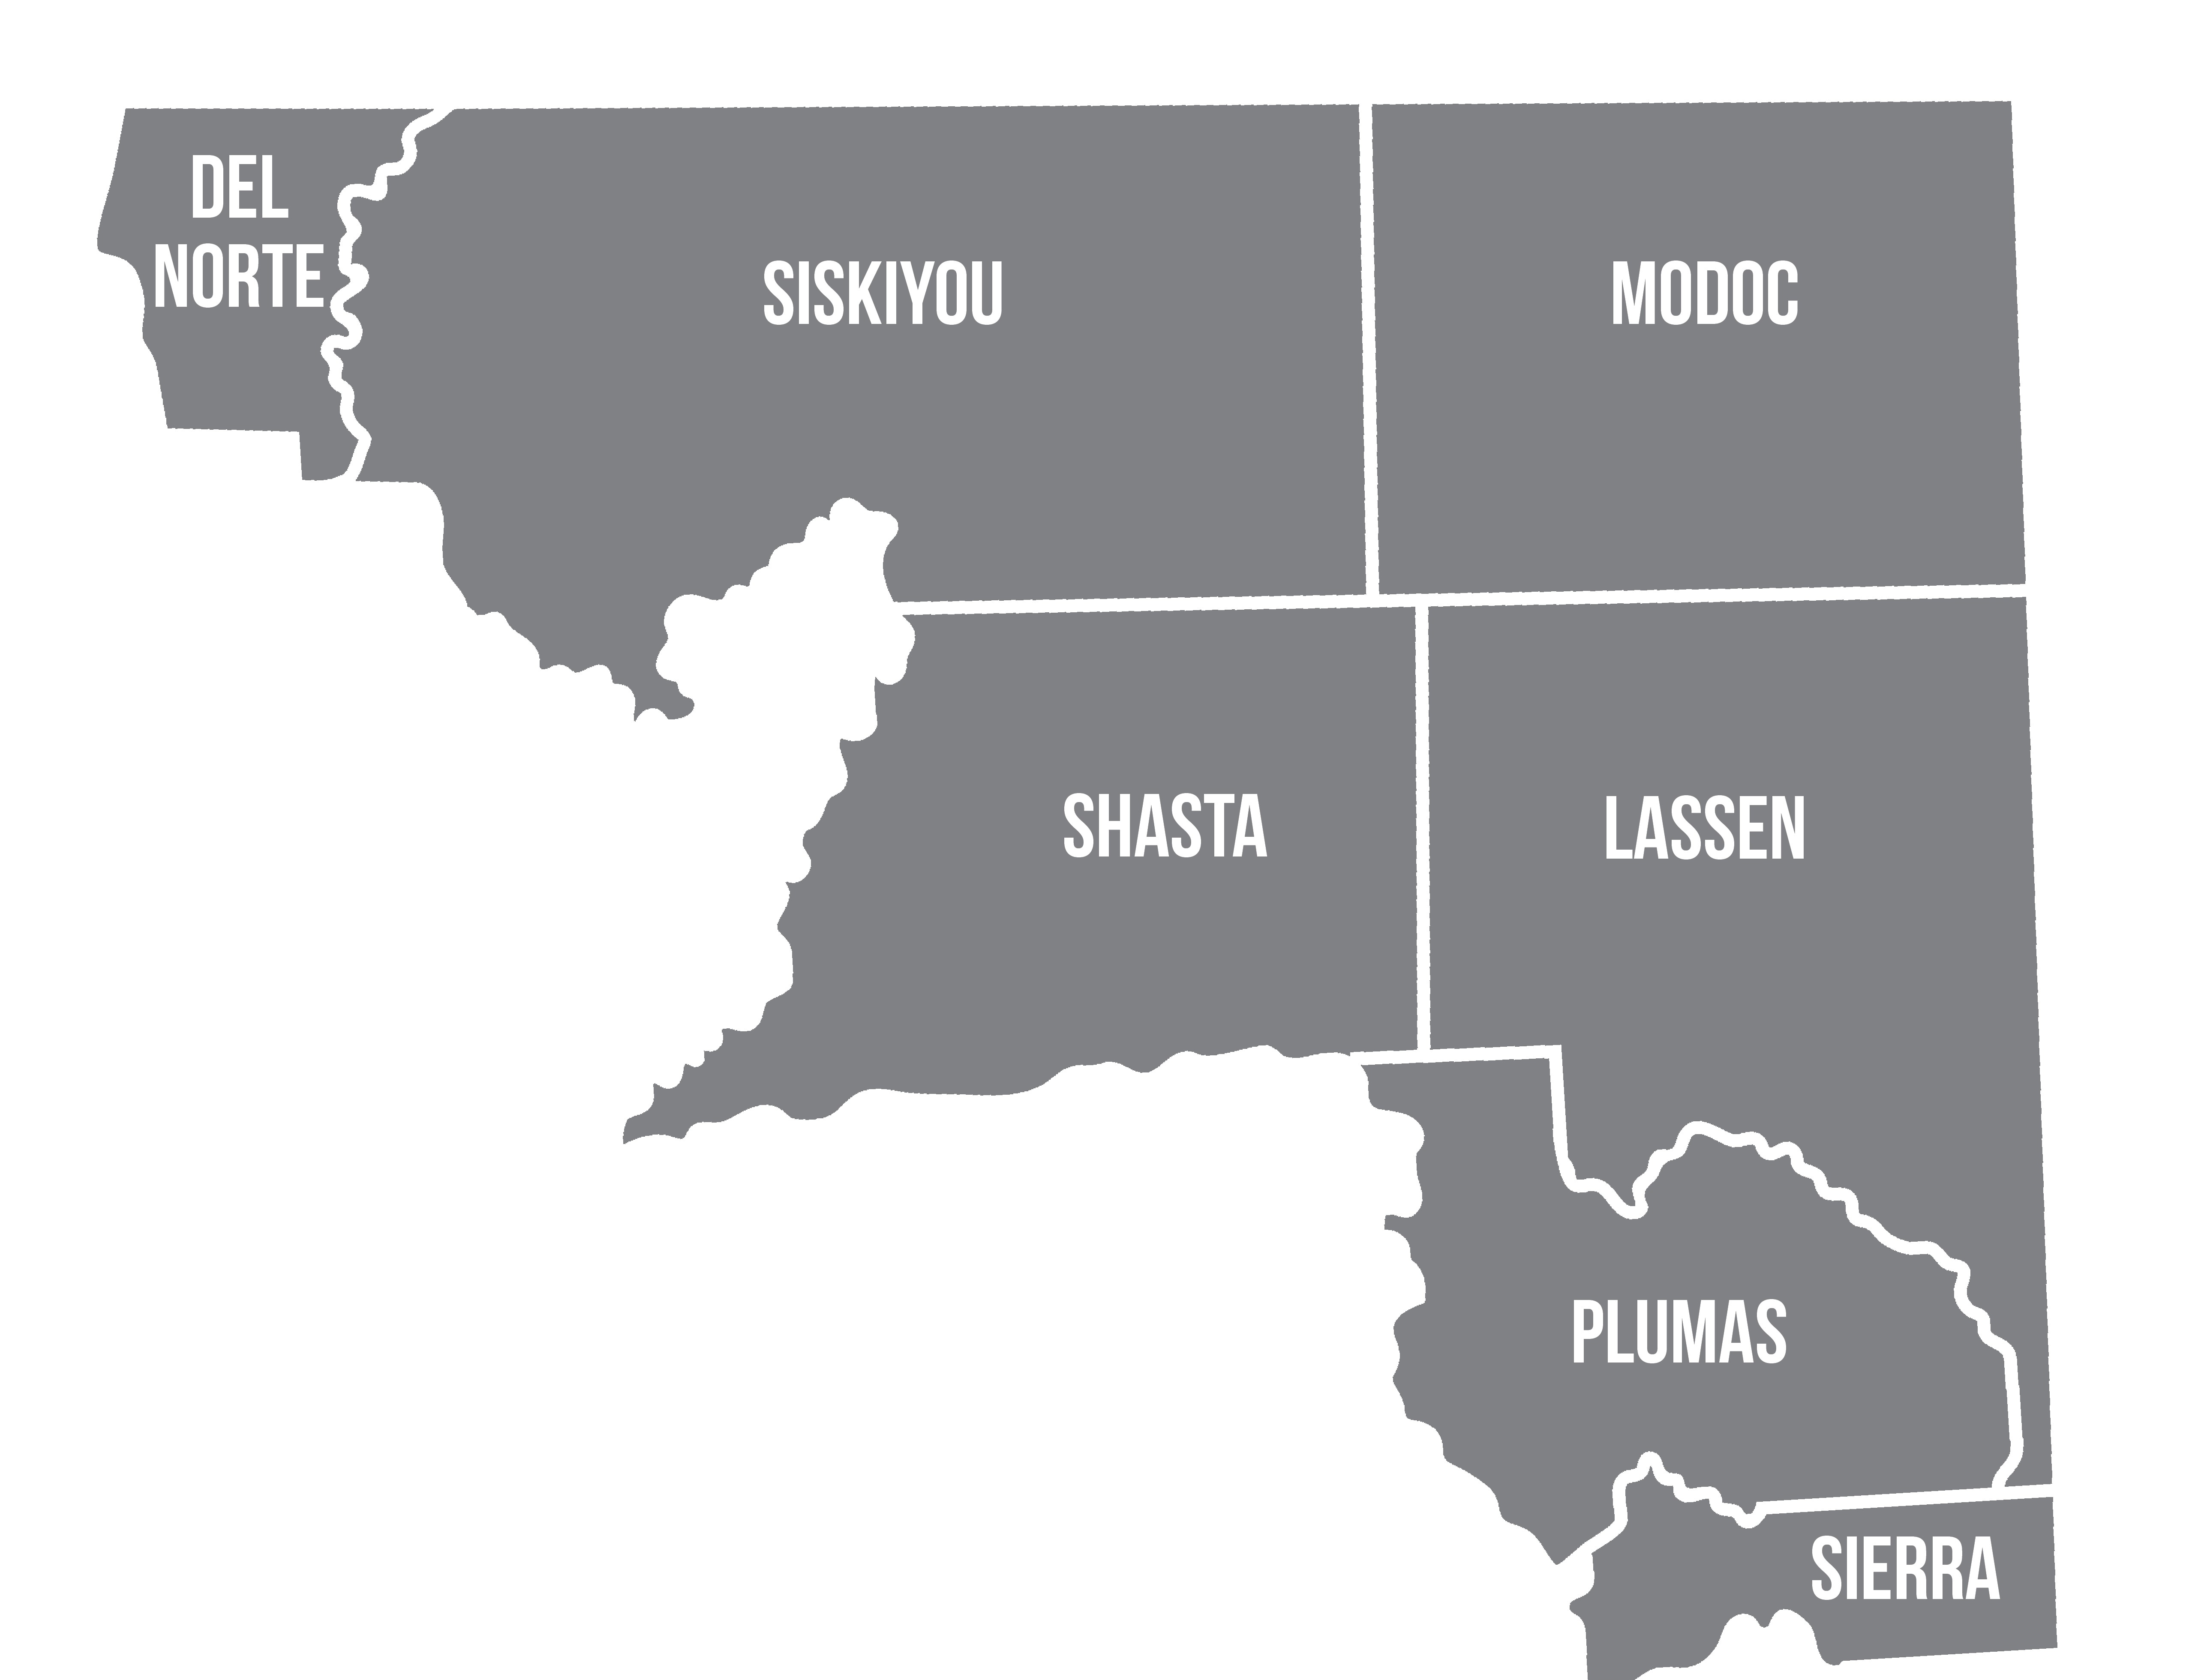
NorCal Continuum of Care Service Area

Slide 6
Background on NorCal
Continuum of Care (CoC)
The Federal Department of Housing & Urban Development created the CoC program. The CoC program is designed to promote community-wide commitment to the goal of ending homelessness; to provide funding for efforts by local governments, nonprofit providers, states, Indian Tribes or tribally designated housing entities.
CoCs are required to designate a “Lead Agency” which enters into funding agreements with HUD (Federal), HCD (State) and Cal ICH (State). The Lead Agency for the NorCal CoC is the City of Redding. There must also be a lead agency for the management of the data-tracking system called HMIS and that lead agency is The United Way of Northern California.
CoCs both receive and pass through funding from a variety of sources, including HUD CoC Funding, State ESG and HHAP funding, and other special funding made available from time to time to CoCs and their county members.

Slide 7
Background on HHAP-5
The Homeless Housing Assistance and Prevention (HHAP) Prevention Program was created by the California State Legislature in 2019. Funding has been released in rounds via Notices of Funding Availability (NOFAs) to eligible applicants.
Eligible applicants for HHAP are the 44 Continuums of Care, 58 counties, and 14 largest cities with populations over 300,000.
This grant program provides local jurisdictions with flexible funding to continue efforts to improve regional and systems coordination to prevent and end homelessness in their communities.

Slide 8
Background on HHAP-5
The Homeless Housing Assistance and Prevention (HHAP) Round 5 Notice of Funding Availability (NOFA) was published Sept 29, 2023.
HHAP-5 requires three public meetings, a Regionally Coordinated Homelessness Action Plan (Plan), a Memorandum of Understanding (MOU) signed by each participating County, and a Funding Plan or Plans (if counties apply to receive and manage their allocations directly from the State).
HHAP-5 allocations consist of an allocation for the entire CoC (which the CoC divides up based on each county’s share of individuals counted in the most recent PIT) and a separate allocation for each county.

Slide 9
HHAP-5 Allocations
Continuum of Care Allocation: $3,625,173.51
County Allocations:
  Del Norte: $957,459.26
  Lassen: $184,869.66
  Modoc: $37,249.86
  Plumas: $184,869.66
  Shasta: $1,397,559.41
  Sierra: $16,555.55
  Siskiyou: $699,469.52

Slide 10
State Priorities
HHAP-5 funds are intended to sustain existing federal, state and local investments toward long-term sustainability of housing and supportive services.
HHAP-5 recipients are required to:
  prioritize permanent housing solutions; and
  address racial disparities for groups disproportionately experiencing homelessness and achieve equitable provision of services for those groups, especially for Black, Native and Indigenous, Hispanic/Latiné, Asian/Pacific Islanders and other People of Color.

Slide 11
Progress on System Performance Measures (SPMs)
System Performance Measures (SPMs) are a series of metrics developed by Cal ICH. These metrics are used by CoCs in the HHAP Plan/Application.
The SPM data comes from the State’s Homeless Data Integration System (HDIS), which processes data from the 44 CoC Homeless Management Information Systems (HMIS).
As part of the HHAP-3 Plan/Application in 2022, the NorCal CoC region set Outcome Goals and Strategies to Achieve Outcome Goals using input from the CoC Executive Board and members. The SPM data for HHAP-5 provides insight on the progress the region has made thus far and will be used to help plan the new or amended Key Actions.

Slide 12
HHAP-3 Outcome Goals & Progress
System Performance Measure | HHAP-3 |  | HHAP-5
 | Calendar Year (CY) 2020 Data | Goal | Calendar Year 2022 Data | Percent Change from CY 2020
1a – Number of people accessing services who are experiencing homelessness | 1,473 | 12% increase | 2,526 | 71% increase
1b – Number of people experiencing unsheltered homelessness | 1,023 | 4.74% increase* | 1,096 | 7% increase
2 – Number of people accessing services who are experiencing homelessness for the first time | 991 | 6% increase | 1,473 | 49% increase
3 – Number of people exiting homelessness into permanent housing | 492 | 13% increase | 676 | 37% increase
*Note: Rather than decreases from baseline, these small increases were deemed to reverse the upward trends that had been experienced in recent years.

Slide 13
HHAP-3 Outcome Goals & Progress
System Performance Measure | HHAP-3 |  | HHAP-5
 | Calendar Year (CY) 2020 Data | Goal | Calendar Year 2022 Data | Percent Change from CY 2020
4 – Average length of time persons remain homeless after entering the Coordinated Entry System | 126 days | 36.8% increase* | 138 days | 9% increase
5 – Percent of people who return to homelessness within six months of exiting to permanent housing | 6% | -1% change point | 3% | -2.93% point change
6 – Number of people with successful placements from street outreach | 2 | 100% increase (to 25 people) | 73 | 3550% increase
*Note: Rather than decreases from baseline, these small increases were deemed to reverse the upward trends that had been experienced in recent years.

Slide 14
Tonight’s Focus:
Pathways to Permanent Housing
Actions from the HHAP-3 and HHAP-4 Plans Relating to Creating Pathways to Permanent Housing:
Provide Housing Navigation and Housing Retention services in each county through an expansion of case management staff and multi-disciplinary teams utilizing HHAP and PLHA funds.
Increase non-congregate shelter options with a connection to Housing Navigation services utilizing a trauma-informed Housing First model.
Expand the supply of permanent supportive housing by utilizing funds from Homekey, PLHA and HHAP to purchase and renovate a minimum of 2 hotels to be operated as permanent supportive housing.

Slide 15
Pathways to Permanent Housing Breakout Groups
HHAP-3 and 4 actions: should any be expanded, improved, or ended?
What projects is your organization working on that relate to the system performance measures?
Are there best practices you know of or a program you’ve wanted to pilot?
How can we include people with lived experience?
Impacts on System Performance Measures:
As your group discusses the questions above, we will ask you to note which System Performance Measures you think the suggested action, project, or practice would impact.

Slide 16
How Breakout Groups Will Work
For groups meeting in-person: you should each have a facilitator and a notetaker in your room with handouts that outline the information from the previous slide and you will all meet separately as one group. Sareena will also virtually place you in a breakout group so that you do not hear any of the online discussions. We will bring you back to the Main Meeting Room when the time is up and your group facilitator or notetaker will share a summary of your discussion.
For those who are online as individuals: we will have 1 or 2 virtual Breakout Groups here on Zoom. Sareena will randomly place you in a group and you will be asked to participate in that group’s virtual meeting room. You will have both a facilitator and notetaker in your Breakout Group. We will bring you back into the Main Meeting Room when the time is up and your group facilitator or notetaker will share a summary of your ideas.
The Breakout Group discussions will take about 40-45 minutes.

Slide 17

Questions and Comments

Slide 18
Schedule and Next Steps
Date | Activity
January 31, 2024 | Public Meeting #1 (tonight, Pathways to Permanent Housing Focus)
February 8, 2024 | Public Meeting #2 (Pathways to Equity Focus)
February 22, 2024 | Public Meeting #3 (Summary of Recommended Actions and Final Public Comments)
Late January to Late February 2024 | Housing Tools Prepares RCHAP and Application Using Feedback from Meetings
Late February to Early March 2024 | CoC Board Will Review RCHAP and Application
March 2024 | Counties’ Governing Body Meetings to Adopt Plan and Approve MOU
No Later Than March 27, 2024 | Submit HHAP-5 Plan/Application to Cal ICH via Online Submission Platform *Note: After submittal, Cal ICH has 90 days in which to review the submitted plan/application, request amendments, or approve application and issue award notice.

